Slide 1
Confidentiality protection and physical safeguards
Lars Vilhuber
Cornell University
Funding acknowledged under NSF-#1131848 (NCRN) and a grant from the Alfred P. Sloan Foundation

Slide 2
confidentiality and access

Slide 3

confidentiality of statistical agency data
“… when the secretary of [Commerce and Labor] directed that the census schedules of manufacturing establishments should be open to the inspection of officials belonging to another bureau within the same department […] and the director [of the Census Bureau] refused [….] because of the pledge of secrecy…”
(Walter Wilcox, 1914)

Slide 4
rich new analysis and publications
held back by concerns of citizens and businesses about privacy
1902
1942
1960
1985
today

Slide 5
access methods
Tabulations
Tabulations
Public-use microdata
Raw microdata
Ease of access
Privacy loss →
← Loss of detail

Slide 6
access methods
Tabulations
Tabulations
Public-use microdata
Raw microdata
Ease of access
Privacy loss
Privacy loss →
← Loss of detail

Slide 7
driven by advances in technology…
“These improvements resulted not only in time and space savings, but cost savings as well, enabling researchers to do more detailed research and respond more quickly to pressing social issues. […] government programs designed to address social issues […] called for more information and data on those issues. […] As research needs grew and research capabilities expanded, […] increasing the demand for data.”
1960s!
Src: Kraus (2011) https://www.census.gov/history/pdf/kraus-natdatacenter.pdf
Notes:
Describing these topics, as Kraus (2011) does, could just as well apply to a text describing today’s topics

Slide 8
professional associations
At the 1959 annual meeting of the American Economic Association, members of the executive committee discussed the need for access to social and economic data for research purposes → Ruggles Report in April 1965
American Statistical Association (ASA) Advisory Committee assisted Bureau of the Budget (pre-OMB) → “Recommendations on Availability of Federal Statistical Materials to Nongovernmental Research Workers,” The American Statistician, vol. 13, no. 4 (October 1959) DOI: 10.1080/00031305.1959.10482600
Notes:
Some of the key players were the statisticians’ and economists’ professional associations

Slide 9
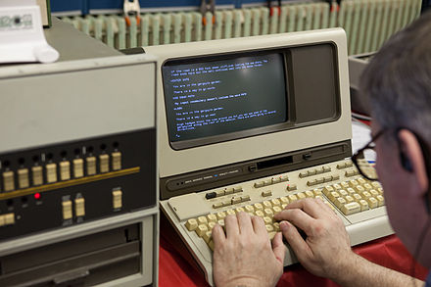

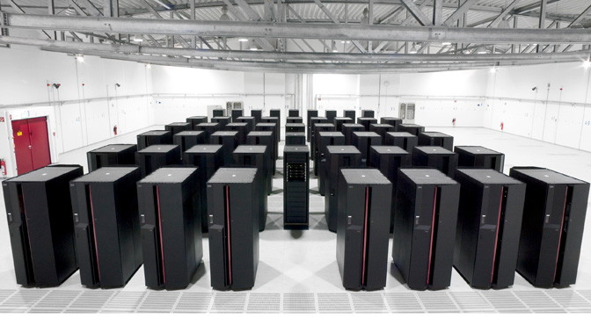
driven by advances in technology
1902
1942
1960
1985
today
Notes:
So technology is advancing, where has it gotten us today in terms of access?

Slide 10
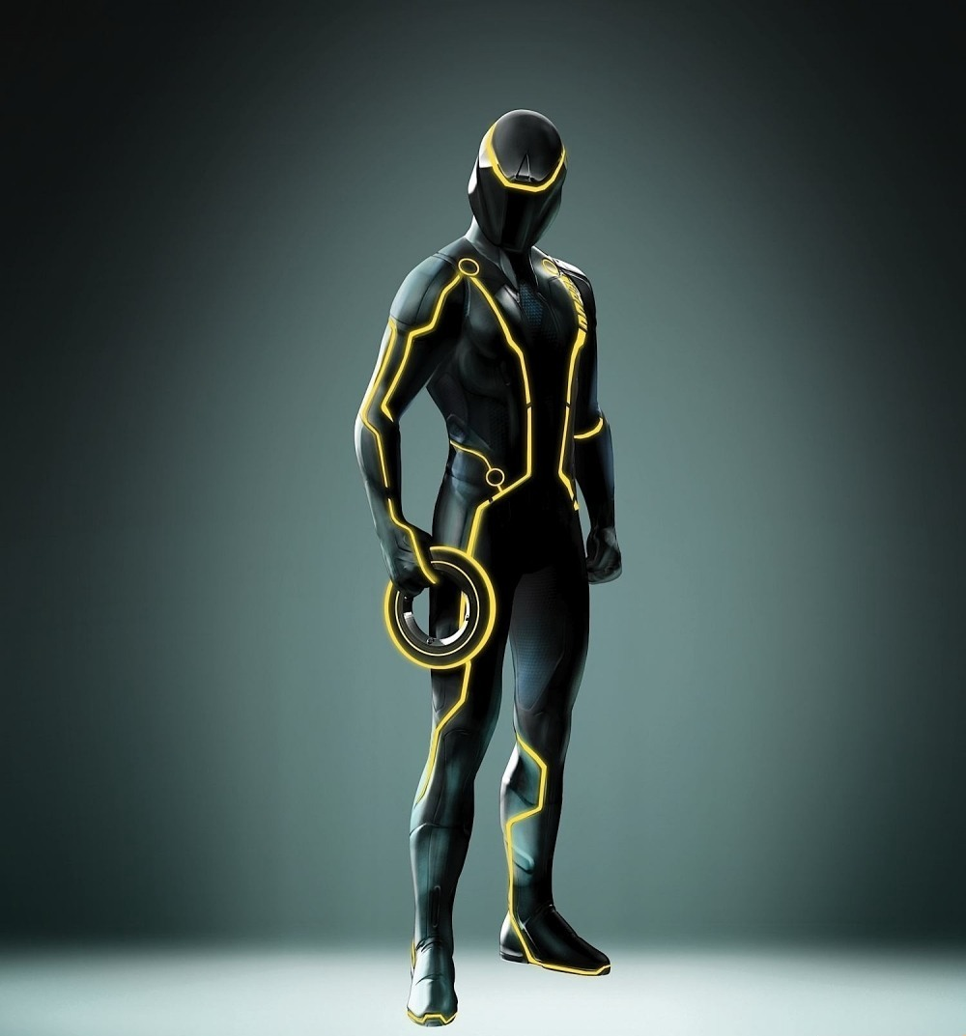


driven by advances in technology
Notes:
(joke): here is tomorrow’s technology (click) and the Census Bureau statistician’s uniform for 2030 Census (click) and the upcoming replacement for the VDI access token… (reference to Tron: Legacy movie)

Slide 11
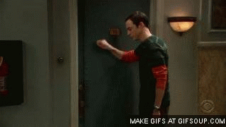
researchers knocking on the door

Slide 12
researcher access and privacy concerns
1960s in the US: proposal for “National Data Bank” with the goal of combining survey and administrative data to make available to researchers
Instead, and partially as a consequence, privacy laws were formalized in the 1970s (“Privacy Act 1974” (Public Law 93-579, 5 U.S.C. § 552a)) specifically prohibited “matching” programs, linking data from different agencies.
More recently: 2016 Australian Census elicited substantial controversy
Identifiable data with explicit goal of enabling linkages between the census and administrative data, as well as linkages across historical censuses
Notes:
Did researchers requesting access to detailed data always get the public approval they were hoping for? No… National Data Bank led to Privacy Act, and more recent controversy about retaining the ability to link census records across time and across datasets in Australia was also highly controversial. (Also might note the 1980s issue with the German census, for similar reasons)

Slide 13
my talk today

Slide 14

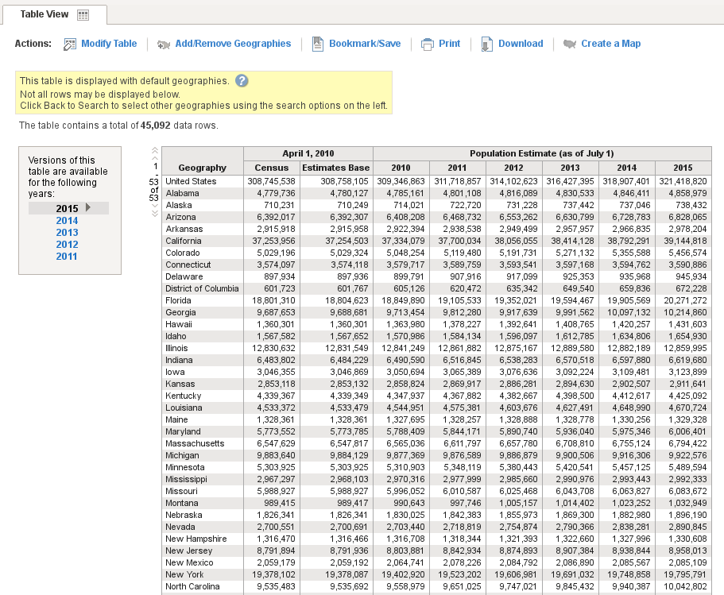
focus
I will focus on access mechanisms for researchers
Source: (Fox News/REUTERS/Kacper Pempel/Files/https://goo.gl/ZHMkog)
I will exclude
Newer mechanisms to create tabular data (synthetic data, differentially-private data)
I will include
Use of analytically-valid synthetic data as an access mechanism

Slide 15
context of my talk today
Focus on researcher access to authorized data collections
Not building new data collections, or enacting new laws
Focus on the mechanisms for providing access
Mostly physical
Access to microdata
Notes:
While the focus is not on building new data collections, the ability to protect existing data obviously has an impact on new data collections (see IMI,

Slide 16
In light of the “Five Safes Framework”
The "Five Safes framework" (Desai, Ritchie, and Welpton, 2016) provides structure to many aspects of providing secure access to data:
Safe projects - evaluating data analysis projects for appropriateness
Safe people - evaluating the credentials of researchers
Safe settings - how can the data be accessed?
Safe data - how sensitive is the data/ can the data be made?
Safe outputs - how sensitive are analysis results

Slide 17
In light of the “Five Safes Framework”
The "Five Safes framework" (Desai, Ritchie, and Welpton, 2016) provides structure to many aspects of providing secure access to data:
Safe projects - evaluating data analysis projects for appropriateness
Safe people - evaluating the credentials of researchers
Safe settings - how can the data be accessed?
Safe data - how sensitive is the data/ can the data be made?
Safe outputs - how sensitive are analysis results
May impact choice of setting
Primary focus
May impact choice of setting

Slide 18
some geographic limitation
Notes:
My experience has a certain Anglo-Saxon and European tint – I happen to have some experience and knowledge with the Brazilian case, but won’t reference that today.

Slide 19
history again

Slide 20
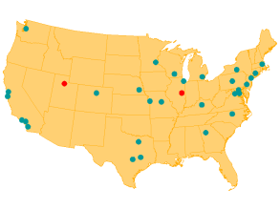
really brief history in the US
Starting in the 1960s and 70s, increased use of public-use microdata samples and surveys
Researcher access at Census Bureau headquarters in the 1970s
1990: [Computing power: 3.5 MFLOPS for $9000]
First RDC at Boston in 1994
A small number of RDCs in the 1990s
Thin clients in the 2000s
2019: 29 RDCs
Notes:
… and so they keep knocking on the door (for reference: iWatch > 1000 Mflops)

Slide 21
other countries: Germany
Institute for Employment Research (IAB), Germany
Commission to improve the informational infrastructure between the scientific community and official statistics
recommended creation of RDCs by producers of microdata (2001)
RDC created in 2004 for “weakly anonymous” data
Scientific use files (factually anonymous data) available under licensing agreements to university data enclaves
2011 first non-European RDC created at University of Michigan
(KVI)
1902
1942
1960
1985
today
2001
2004
2011
16 RDCs in 5 countries
Notes:
I‘m only going to focus on a few other countries that demonstrate some of the features I want to highlight
Kommission zur Verbesserung der informationellen Infrastruktur zwischen Wissenschaft und Statistik, KVI

Slide 22
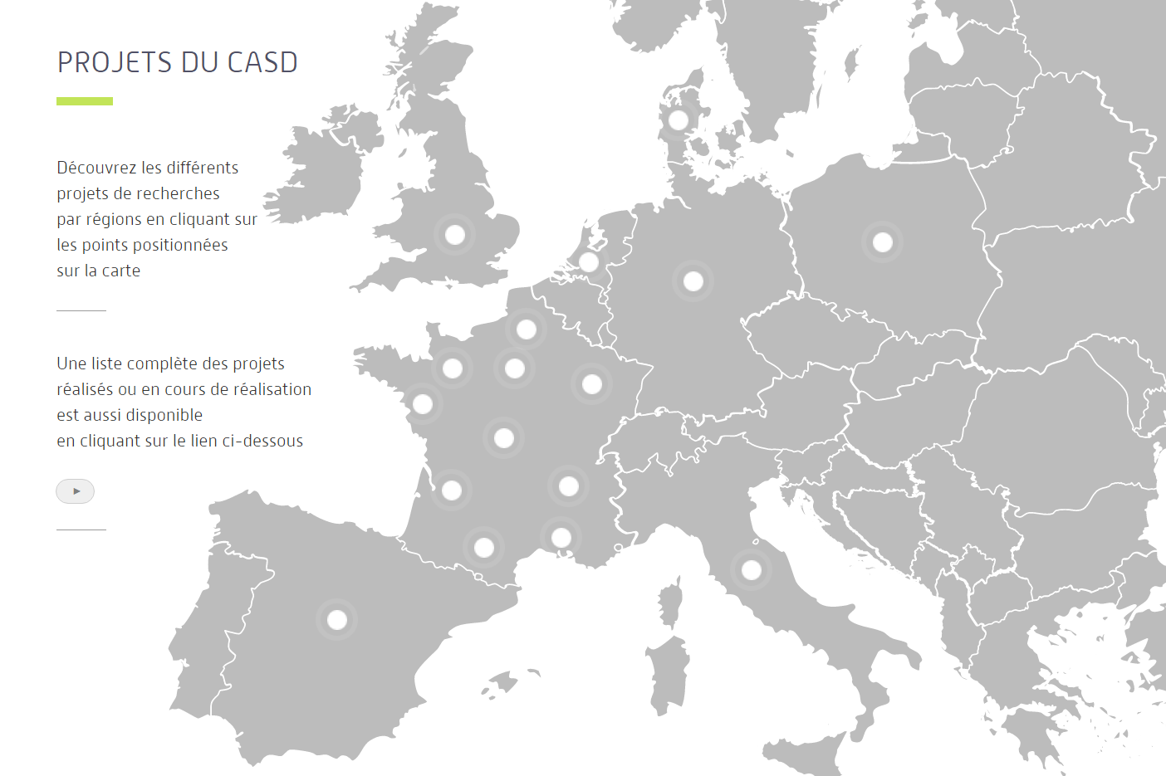
other countries: France
Centre d’accès securisé distant (CASD, France)
INSEE recommended implementing a secure center for accessing data (2007)
2008 modification to Statistics Law made possible pilot infrastructure
Pilot infrastructure becomes permanent in 2009
Expansion with per-project cost (invoicing) in 2012
Loi Informatique et Libertés (1978)
1985
1995
2008
2012
2018
1990
1st working group
2007
2009
371 APs in 8 countries
Source: presentation to the CASD Scientific Committee in 2013
Notes:
1990 census was a trigger, when increased demand hit stronger privacy protection – demographers and sociologists
CREST was the original privileged access holder to data, but a driver in making it a more public entity.

Slide 23
mechanisms

Slide 24
Variation in access mechanisms
 | USA | France | Germany | Canada
Physical enclave | Yes | No | Yes/ No | Yes
Data in same enclave | No | -- | No | Yes
Custom hardware | No | Yes | No | No
Standard hardware | Yes | Yes | Yes | No
Multiple data sources/providers | Yes | Yes | No | No/Yes

Slide 25
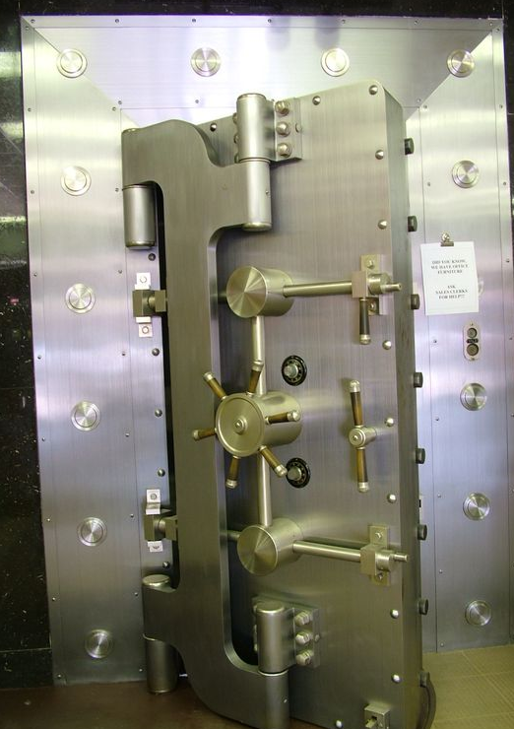
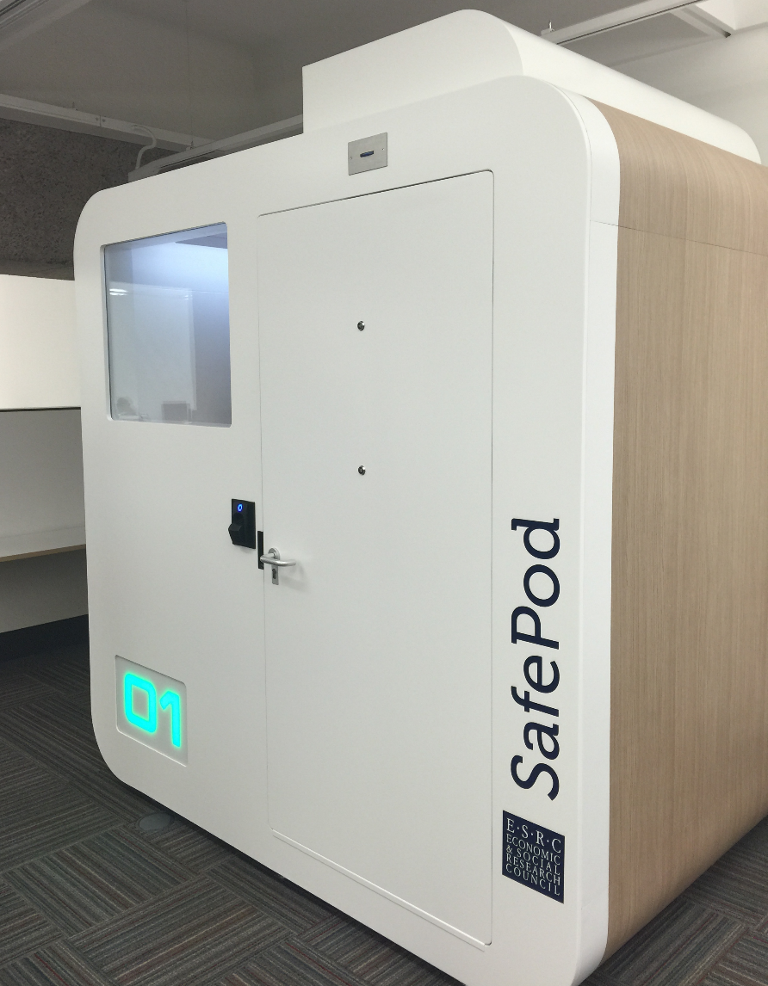
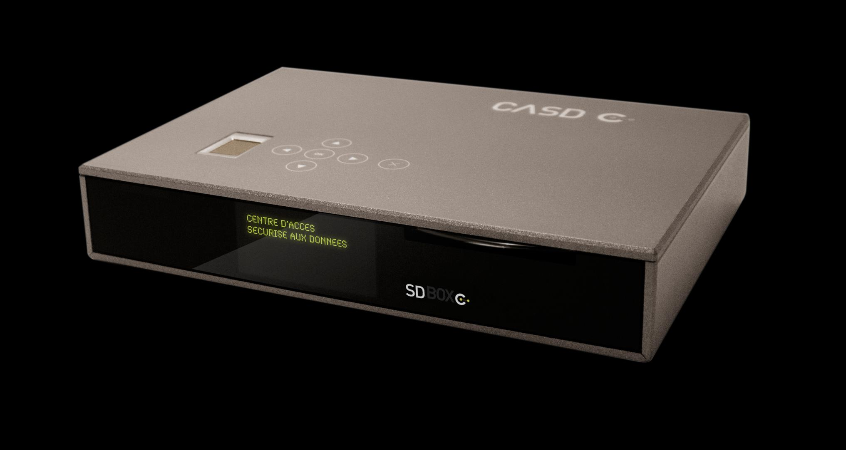
newer methods: Data Enclaves
custom tabulations (by staff) became too onerous
tabulation and analysis work offloaded onto researchers by providing them with access to protected microdata

Slide 26
what is a data enclave?
Secure and authorized room
May be under control of statistical agency but possibly outside the agency (“embassy” model)
In some cases may be under contractual control (university)
May be used to describe
The room housing the data
The room which the researcher enters
When the two differ: “Virtual Data Enclave”

Slide 27
access methods: enclaves
Tabulations
Tabulations
Public-use microdata
Software on your own PC giving a view onto secure data environment, with manual DA
Remote desktop
Ease of use
Thin client
Secondary secure PC giving a view onto secure data environment, with manual DA
Remote execution
Privacy loss
Submitting analysis programs by email or through website, with manual disclosure avoidance (DA) (possibly combined with synthetic microdata)
RDC
← Loss of detail

Slide 28
access methods: enclaves with researcher-controlled release
Tabulations
Tabulations
Public-use microdata
Self-controlled release
Raw microdata
Remote desktop
Ease of use
Thin client
Remote execution
RDC
← Loss of detail

Slide 29
access methods: enclaves with researcher-controlled release
Tabulations
Tabulations
Public-use microdata
Raw microdata
Remote desktop
Ease of use
Thin client
Self-controlled release
Remote execution
RDC
← Loss of detail

Slide 30

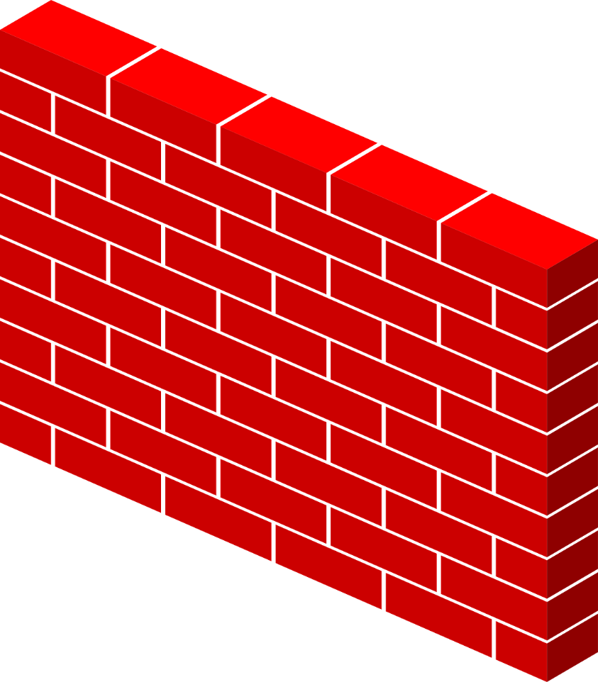

basic paradigm
What type of access device?
What type of room?

Slide 31
basic paradigm
What type of access device?
What type of room?

Slide 32



basic paradigm

Slide 33
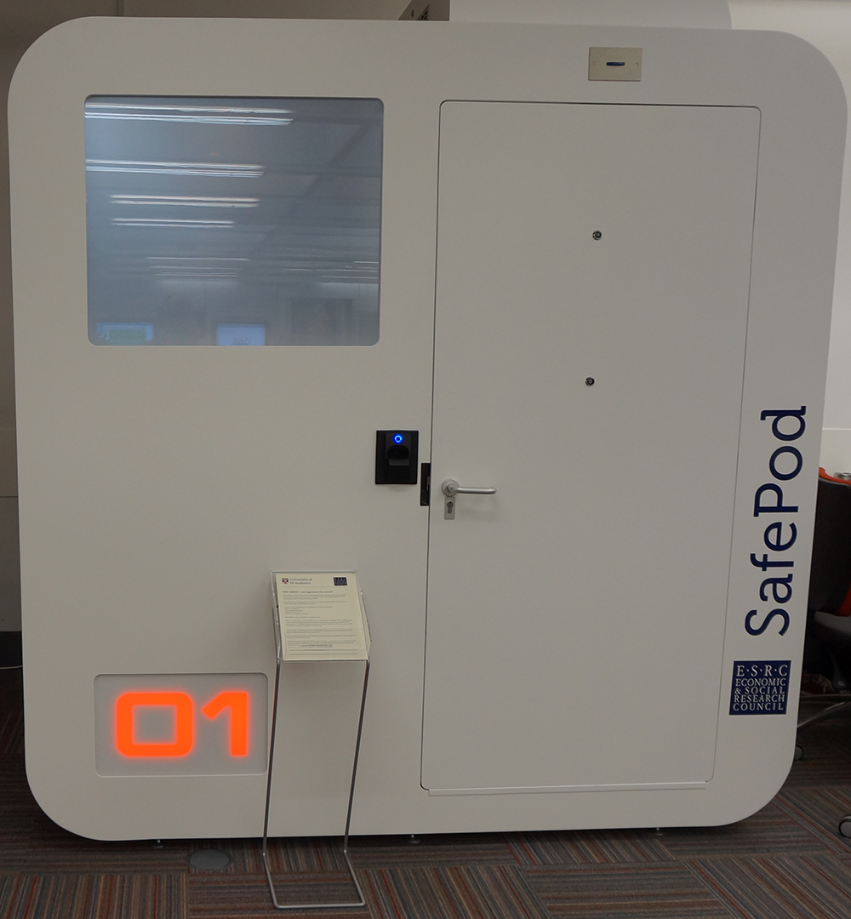
“safe spaces”: that spaceship thing…
Pre-fabricated secure room
First one installed in 2015 at University of St. Andrews (Scotland/UK)
2.3m x 1.8m
Electronic locking, biometric recognition, CCTV, “Smart Glass”
£ 25,000 ~ $30,000 incl. installation
Part of UK ADRN
[For now: EU]
(7’6” x 5’10”)
Source: http://libanswers.st-andrews.ac.uk/faq/93548

Slide 34
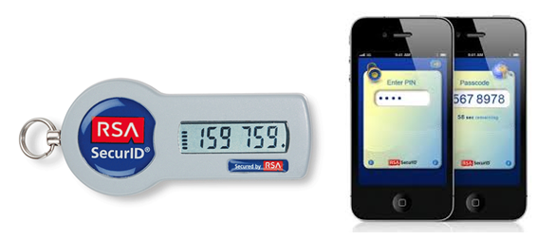

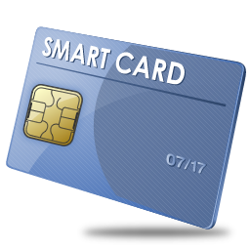
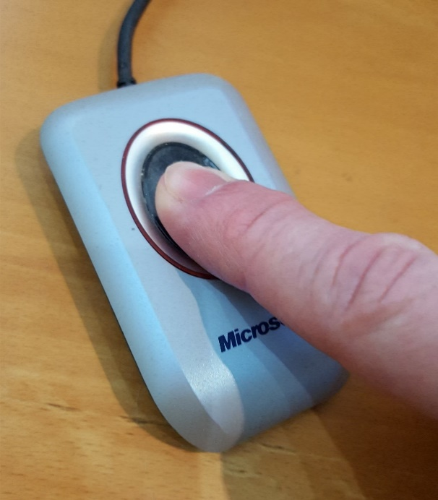
access devices: thin clients
With the notable exception of the Canadian RDCs (for now), thin clients are the preferred method of access
Surrounded by walls = RDC [FSRDC in US, Germany, others]
Embedded in a managed device = “thin client” [above, plus France]
Software with a managed access token = “remote desktop” or “VDI” [some US agencies; DK, Finland]
Additional controls may be
IP address control [many]
Biometric authentication [France]
Smart card [France, US]
70.48.127.42

Slide 35
thin clients: examples
Often off-the-rack devices
Custom remote access device used at CASD
Encrypted storage, biometric smartcard reader, pre-configured VPN
€35.00 / month, first user free, additional users €37.00 - €20.00 / month (decreasing)

Slide 36
thin clients: examples
Software-based VPN
Software-based remote access software (Citrix, RDP, etc.)
Combined with various levels of 2FA
Software or hardware tokens
IP address limits

Slide 37
scalability (CASD)
… added in 2016 alone
Totals
71 access points
232 users
62 projects
371 access points
1402 users
472 projects

Slide 38
Access matrix for confidential data
Control of: | Data access | Analysis computers | Access computers | Access rooms | Analysis methods
FSRDC researcher | Full | Full | Full | Full (badge access) | Some (choice of software)
Census employee | Full | Full | None (VDI) | None (VDI) | Some (choice of software)
Control of: | Data access | Analysis computers | Access computers | Access rooms | Analysis methods
FSRDC researcher | Full | Full | Full | Full (badge access) | Some (choice of software)
Census employee | Full | Full | None (VDI) | None (VDI) | Some (choice of software)
IAB: RDC researcher | Full | Full | Full | Full (trusted person) | Some (choice of software)
IAB: JoSuA researcher | Full | Full | None (Web application) | None (Web application) | Smaller (software, whitelist commands)
Control of: | Data access | Analysis computers | Access computers | Access rooms | Analysis methods
FSRDC researcher | Full | Full | Full | Full (badge access) | Some (choice of software)
Census employee | Full | Full | None (VDI) | None (VDI) | Some (choice of software)
IAB: RDC researcher | Full | Full | Full | Full (trusted person) | Some (choice of software)
IAB: JoSuA researcher | Full | Full | None (Web application) | None (Web application) | Smaller (software, whitelist commands)
IAB employee | Full | Full | Full (IAB laptop) | None (VDI) | Some (choice of software)
Control of: | Data access | Analysis computers | Access computers | Access rooms | Analysis methods
FSRDC researcher | Full | Full | Full | Full (badge access) | Some (choice of software)
Census employee | Full | Full | None (VDI) | None (VDI) | Some (choice of software)
IAB: RDC researcher | Full | Full | Full | Full (trusted person) | Some (choice of software)
IAB: JoSuA researcher | Full | Full | None (Web application) | None (Web application) | Smaller (software, whitelist commands)
IAB employee | Full | Full | Full (IAB laptop) | None (VDI) | Some (choice of software)
CASD researcher | Full | Full | Extra Full (custom-built hardware) | Some (university office, EU) | Some (choice of software)
Control of: | Data access | Analysis computers | Access computers | Access rooms | Analysis methods

Slide 39
Access matrix for confidential data
Control of: | Data access | Analysis computers | Access computers | Access rooms | Analysis methods
FSRDC researcher | Full | Full | Full | Full (badge access) | Some (choice of software)
Stat.Denmark (typical EU) | Full | Full | None (VDI) - Some (host institution) | None (VDI) -Some (host institution) | Some (choice of software)
RDC Canada | Some (demog. only) | Some (host institution) | Some (host institution) | Full (badge access) | Some (choice of software)
Stat.Canada (typical of HQ) | Full (incl. business) | Full | Full | Full | Some (choice of software)
RDC Canada (thin client) | planned
Notes:
HQ also in Netherlands (drivable), replaced with Denmark-style VDI from university locations. HQ approach also in Brazil (Rio) – Instituto brasileiro da geografía e estatística. Canada: enclaves of StatCan within universities, owned and operated by universities, on university computers, under supervision and authorization of StatCan

Slide 40
Access matrix for confidential data
Control of: | Data access | Analysis computers | Access computers | Access rooms | Analysis methods
FSRDC researcher | Full | Full | Full | Full (badge access) | Some (choice of software)
Census employee | Full | Full | None (VDI) | None (VDI) | Some (choice of software)
IAB: JoSuA researcher | Full | Full | None (Web application) | None (Web application) | Smaller (software, whitelist commands)
CASD researcher | Full | Full | Extra Full (custom-built hardware) | Some (university office, EU) | Some (choice of software)
Stat.Denmark (typical EU) | Full | Full | None (VDI) - Some (host institution) | None (VDI) -Some (host institution) | Some (choice of software)
Notes:
Not worry about IAB RDC: lower threshold for rooms, but insubstantial (very similar to FSRDC). Remove the IAB employee (note also similarity to StatCan internal computers).

Slide 41
Access matrix for confidential data
Control of: | Data access | Access computers | Access rooms | Analysis methods
FSRDC researcher | Full | Full | Full (badge access) | Some (choice of software)
Census employee | Full | None (VDI) | None (VDI) | Some (choice of software)
IAB: JoSuA researcher | Full | None (Web application) | None (Web application) | Smaller (software, whitelist commands)
CASD researcher | Full | Extra Full (custom-built hardware) | Some (university office, EU) | Some (choice of software)
Stat.Denmark (typical EU) | Full | None (VDI) - Some (host institution) | None (VDI) -Some (host institution) | Some (choice of software)
Control of: | Data access | Access computers | Access rooms | Analysis methods | Disclosure avoidance
FSRDC researcher | Full | Full | Full (badge access) | Some (choice of software) | Manual/ variety of rules
Census employee | Full | None (VDI) | None (VDI) | Some (choice of software) | Manual/ self/ variety of rules
IAB: JoSuA researcher | Full | None (Web application) | None (Web application) | Smaller (software, whitelist commands) | Manual/ variety of rules
CASD researcher | Full | Extra Full (custom-built hardware) | Some (university office, EU) | Some (choice of software) | Manual/ variety of rules €300/ pack of 10
Stat.Denmark (typical EU) | Full | None (VDI) - Some (host institution) | None (VDI) -Some (host institution) | Some (choice of software) | Manual/ self/ variety of rules
Control of: | Data access | Analysis computers | Access computers | Access rooms | Analysis methods
FSRDC researcher | Full | Full | Full | Full (badge access) | Some (choice of software)
Census employee | Full | Full | None (VDI) | None (VDI) | Some (choice of software)
IAB: JoSuA researcher | Full | Full | None (Web application) | None (Web application) | Smaller (software, whitelist commands)
CASD researcher | Full | Full | Extra Full (custom-built hardware) | Some (university office, EU) | Some (choice of software)
Stat.Denmark (typical EU) | Full | Full | None (VDI) - Some (host institution) | None (VDI) -Some (host institution) | Some (choice of software)
Notes:
Not worry about IAB RDC: lower threshold for rooms, but insubstantial (very similar to FSRDC). Remove the IAB employee (note also similarity to StatCan internal computers).

Slide 42




remote processing paradigm

Slide 43
remote processing paradigm

Slide 44
Access matrix for remote submission
Control of: | Access computers | Access rules | Analysis methods | Disclosure avoidance | Cost
CB: Synthetic data | Custom compute cluster | Simplified proposal | Any (SAS, R Stata, Matlab) | Manual/ traditional | $0
IAB: JoSuA researcher | Web application | Full proposal | Smaller (Stata, whitelist commands) | Manual/ traditional | $0
Australian TableBuilder | Web application | Registration | Tables only | Embedded/ tab. noise infusion | $0/ >$0
Canada RTRA | Upload through Web | Simplified proposal + license | Smaller (SAS, whitelist commands) | Automated controlled rounding | $0
NCHS | Upload through FTP | Full proposal | Smaller (SAS, whitelist commands) | Manual/ traditional | $750/mth
Control of: | Access computers | Access rules | Analysis methods | Disclosure avoidance | Cost
CB: MAS/AQS | Web application | None (?) | Smallest (whitelist commands) | Embedded/ various | $0
Control of: | Access computers | Access rules | Analysis methods | Disclosure avoidance | Cost
CB: Synthetic data | Custom compute cluster | Simplified proposal | Any (SAS, R Stata, Matlab) | Manual/ traditional | $0
Notes:
Synthetic data is NOT a remote submission system, but it is a access mechanism

Slide 45
The ultimate remote submission
Co-author with an employee of stats agency…
Notes:
(this is a joke)

Slide 46
remote access setup
Some setup required
Maybe require some “on-site” access [IAB]
May require billing to be set up [NCHS, others]
May require custom statistical language/limitations
Testing in order to process remotely
Dummy or test files [IAB], “Synthetic” files [StatCan], Pre-defined data dictionaries [NCHS] to test syntax
Analytically valid synthetic data [US/Cornell] to develop models

Slide 47
data/output release methods
Manual disclosure avoidance analysis [most]
Self-disclosure by researcher [Denmark]
Automated disclosure avoidance
Verification server [in combination with synthetic data]
Free [most] or metered [F, NCHS]

Slide 48
summary
To implement “safe spaces”, physical controls matter
Various degrees of control over the physical space for the researcher
[none] - [custom-built secure room in state facility]
Mostly remote access to data stored in secure computing facilities
Various degrees of control over physical devices used for access
[software only] - [custom-built secure devices]

Slide 49
summary
To implement “safe spaces”, physical controls matter
But:
Not independent of the four other safes, in particular
safe data
safe people

Slide 50

thank you
lars.vilhuber@cornell.edu

Slide 51
Thanks
Stefan Bender (formerly IAB and now Bundesbank, Germany)
Jörg Heining (IAB, Germany)
Roxanne Silberman (CASD, France)
Kamel Gadouche (CASD, France)
Jean Poirier (CIQSS, Canada)

Slide 52
Some References
Walter Wilcox (1914) cited in Anderson, Margo J., and Seltzer, William. “Federal Statistical Confidentiality and Business Data: Twentieth Century Challenges and Continuing Issues’.” Journal of Privacy and Confidentiality 1.1 (2009): 7-52, 55-58.
Kohlmann, Annette (2005): “The Research Data Centre of the Federal Employment Service in the Institute for Employment Research.” In: Schmollers Jahrbuch 125, 437-447
Allmendinger, Jutta and Kohlmann, Annette (2005) “Datenverfügbarkeit und Datenzugang am Forschungsdatenzentrum der Bundesagentur für Arbeit im Institut für Arbeitsmarkt- und Berufsforschung”. In: Allgemeines Statistisches Archiv 89, S. 159-182
Heining, Jörg (2010): “The Research Data Centre of the German Federal Employment Agency: data supply and demand between 2004 and 2009.” In: Zeitschrift für ArbeitsmarktForschung, Jg. 42, H. 4, S. 337-350. http://www.iab.de/389/section.aspx/Publikation/k100128n09
Kargus, Andrea; Müller, Anne (2014): “Auch in Nürnberg möglich: Von der zweiten Liga in die Champions League - ein Gespräch mit Stefan Bender.” In: IAB-Forum, Nr. 2, S. 38-45. http://www.iab.de/188/section.aspx/Publikation/k141201301
Kraus, Rebecca S. (2011): “Statistical Déjà Vu: The National Data Center Proposal of 1965 and Its Descendants.” Presentation at JSM 2011. https://www.census.gov/history/pdf/kraus-natdatacenter.pdf

